Slide 1
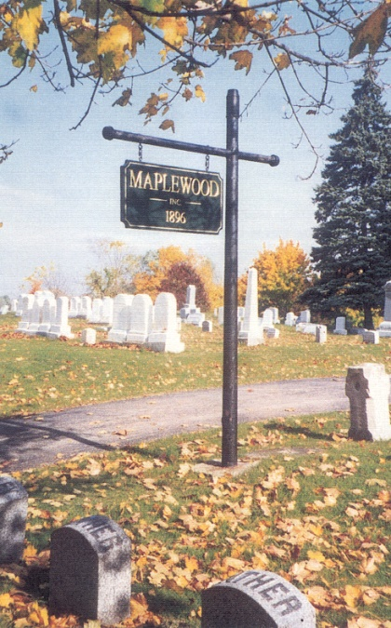
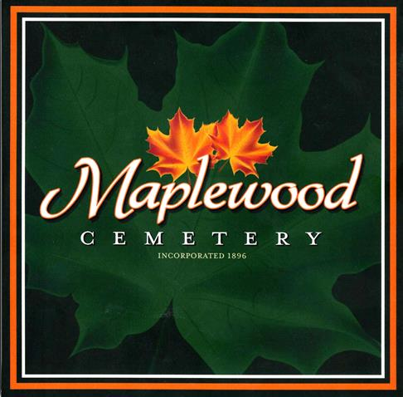
Welcome to the
127th Annual Meeting of the
Maplewood Cemetery Association

Slide 2

Welcome to the
127th Annual Meeting of the
Maplewood Cemetery Association
March 6, 2024

Slide 3


About Us….
Maplewood Cemetery is owned and operated by the Maplewood Cemetery Association which was incorporated in 1896 as a NY Cemetery Corporation.
Maplewood Cemetery is a not-for-profit, volunteer run, charitable organization made up of member-owners elected to the Association Board of Directors. The Board of Directors manages the cemetery corporation, appoints a superintendent, elects Officers for various functions and positions to make sure the cemetery grounds and business is properly operated, maintained and meets all of the required NY state and Federal regulations for cemeteries and non-profit corporations.
Maplewood Cemetery Association is closely regulated, audited and inspected by the N.Y.S. Division of Cemeteries and operates in the public interest rather than as a profit-making venture.
Maplewood Cemetery is also a member of the N.Y. State Association of Cemeteries which is dedicated to the furtherance of effective cemetery management and operation for better community service.

Slide 4
CEMETERY REGULATION IN NEW YORK STATE
New York is the most populous of the six states (including, Connecticut, Massachusetts, Maine, New Jersey, and Wyoming) in which cemeteries are required to be operated only on a non-profit basis. New York State's historical not for profit cemetery structure "for the mutual benefit of plot owners therein" is based upon the following aims:
to protect the well-being of its citizens;
to promote the public welfare;
to prevent cemeteries from falling into disrepair and dilapidation; and
to prevent cemeteries from becoming a burden upon the community. "for the mutual benefit of plot owners therein." Not-for-Profit Corporation Law (N-PCL) §1501.
In 1847 New York passed its first general law "authorizing the incorporation of rural cemetery associations." Over the next 100 years, many provisions were added relative to cemetery associations or corporations, resulting in the Membership Corporations Law (MCL) Article 9 (sections 70-105). This portion of the MCL was repealed and replaced with no change in form or substance by N-PCL §1401, effective in 1970. In 1977 N-PCL §1401, with all its myriad subdivisions, was enacted into current N-PCL Article 15 (sections 1501-1515).
The New York State Cemetery Board was created by statute in 1949 following a 1949 Report of the Attorney General, which was a study of operations and financial activities harmful to cemeteries.

Slide 5
The Division of Cemeteries and the New York State Cemetery Board regulate only those cemeteries that are incorporated under the Not-for-Profit Corporation Law.
Cemeteries that do not fall under our jurisdiction include religious, municipal, private, national and family cemeteries.
The Cemetery Board oversees the Division of Cemeteries' operations and administers the New York State Cemetery Law. The Cemetery Law sets standards for the establishment, maintenance, and preservation of burial grounds in New York State.
The Cemetery Board is made up of the New York State Secretary of State, the New York State Attorney General and the New York State Commissioner of Health.

Slide 6
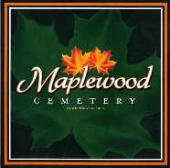
Welcome to the
127th Annual Meeting of the
Maplewood Cemetery Association
Meeting Agenda:
Secretary – Read minutes from 2023 Annual Meeting
Treasurer – Business report for FY2023
Finance – Investment report for FY2023
Superintendent – Operations report
Grounds – Grounds status and activities
Sunshine – Report of events
Nominating – Review upcoming Board terms, changes and openings
Web and Database - status and updates
Brief History of Maplewood Cemetery
New Business - Projects, Discussions, Next Steps
General Discussions – Feedback, Issues
March 6, 2024

Slide 7
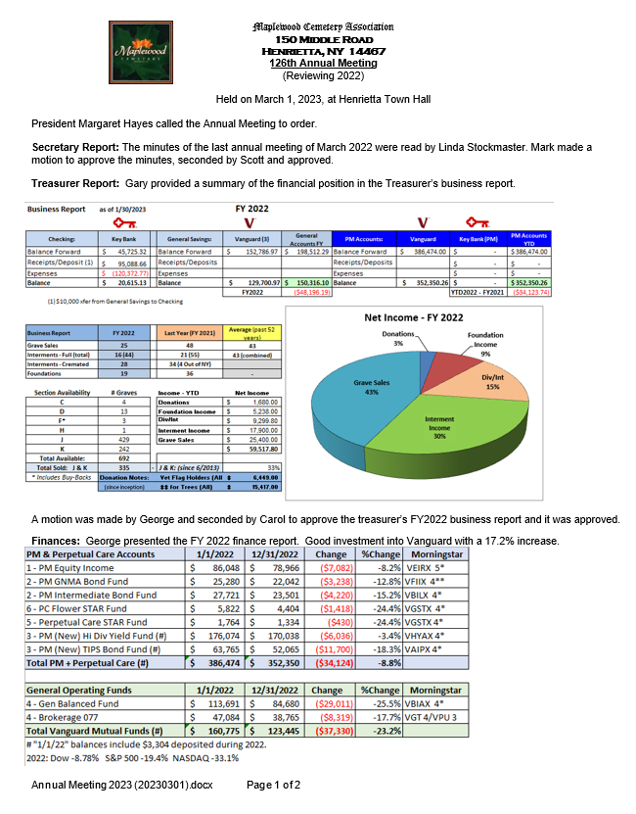
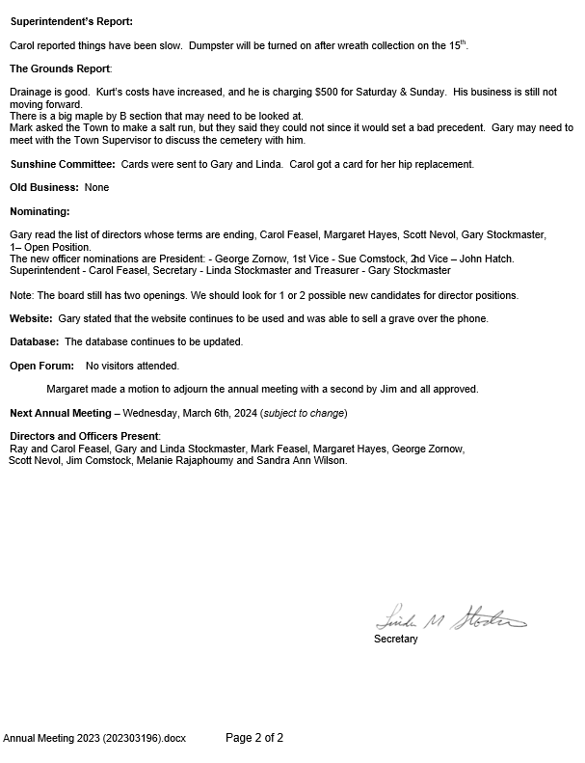

Slide 8
Maplewood Cemetery Association – 2024 Annual Meeting
Business Report - Reviewing 2023
2023 by the Numbers
Sections J & K are now 10 years old
  337 Graves sold in J & K so far (33%)
2023 Grave Sales: 51
Total Interments: 56
  Interments - Full Burial: 18
  Interments - Cremated: 38
  Pets: 0
New Monuments & Foundations: 35
0 Available Graves in Section F
  Section F unused graves are being purchased and resold
Cemetery Voicemail call volume: >250 calls

Slide 9
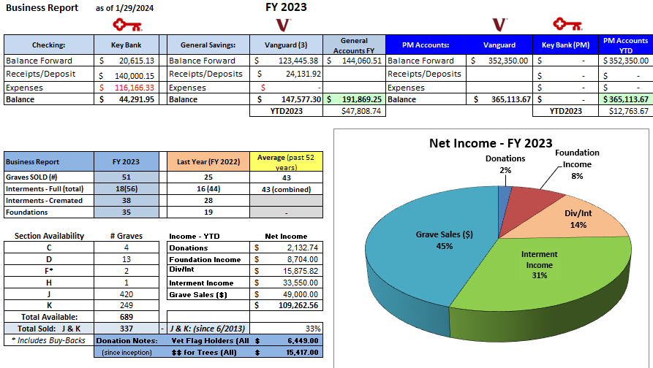
Maplewood Cemetery Association – 2024 Annual Meeting

Slide 10
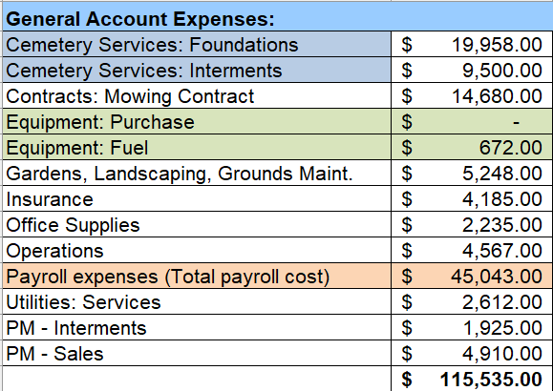
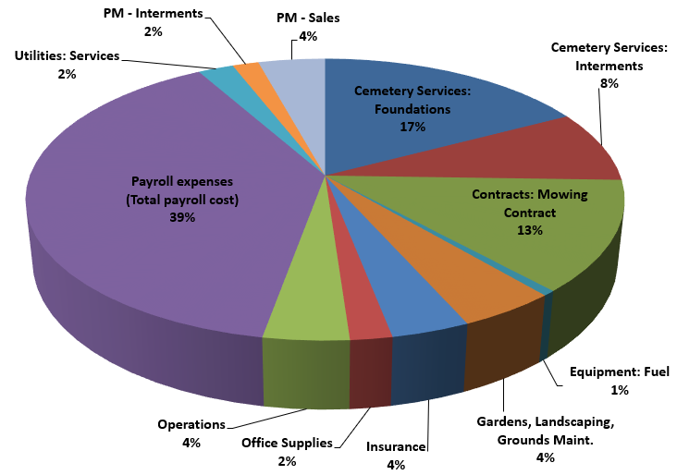
Maplewood Cemetery Association – 2024 Annual Meeting
Business Report - Reviewing 2023 – Major Expense Categories

Slide 11
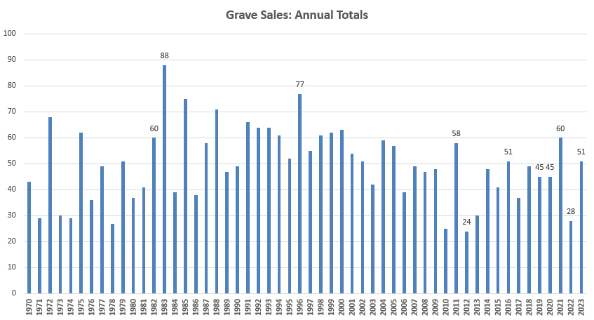
Maplewood Cemetery Association – 2024 Annual Meeting
Notes:
See MWC Annual Grave Sales and Interments 1968-2018 (20190221) in the Reports and Findings folder

Slide 12
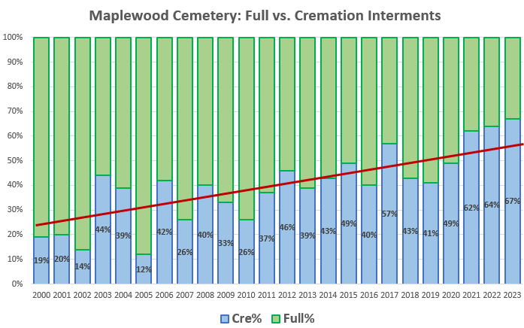
Maplewood Cemetery Association – 2024 Annual Meeting
U.S. Cremation Rate Expected to Top 80% by 2045
National Funeral Directors Association’s (NFDA) 2023 Cremation and Burial Report.
Notes:
See MWC Annual Grave Sales and Interments 1968-2018 (20190221) in the Reports and Findings folder

Slide 13
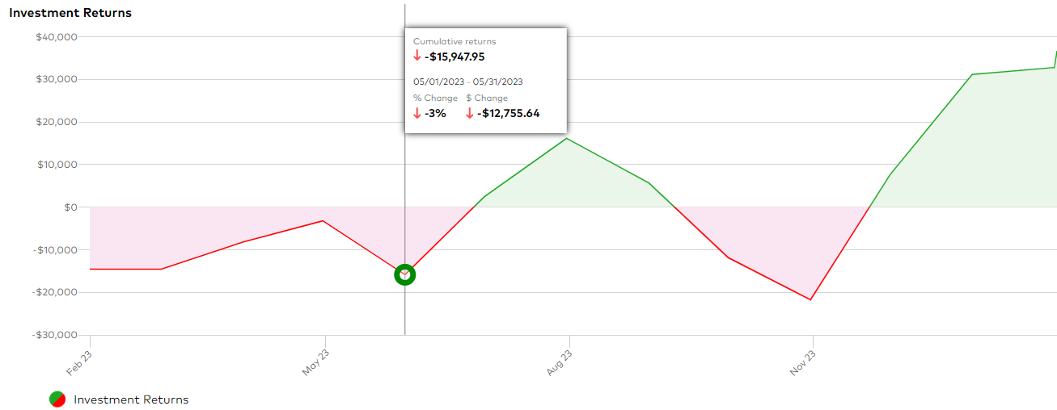
Maplewood Cemetery Association – 2024 Annual Meeting
Finance Report - Reviewing 2023 – Investment Year Performance

Slide 14
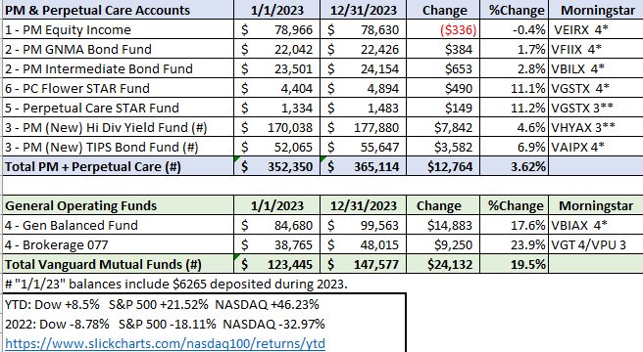
Maplewood Cemetery Association – 2024 Annual Meeting
Finance Report - Reviewing 2023 – Investment Year Performance

Slide 15
Welcome to the
127th Annual Meeting of the
Maplewood Cemetery Association
Meeting Agenda:
Secretary – Read minutes from 2023 Annual Meeting
Treasurer – Business report for FY2023
Finance – Investment report for FY2023
Superintendent – Operations report
Grounds – Grounds status and activities
Sunshine – Report of events
Nominating – Review upcoming Board terms, changes and openings
Web and Database - status and updates
Brief History of Maplewood Cemetery
New Business - Projects, Discussions, Next Steps
General Discussions – Feedback, Issues
March 6, 2024

Slide 16
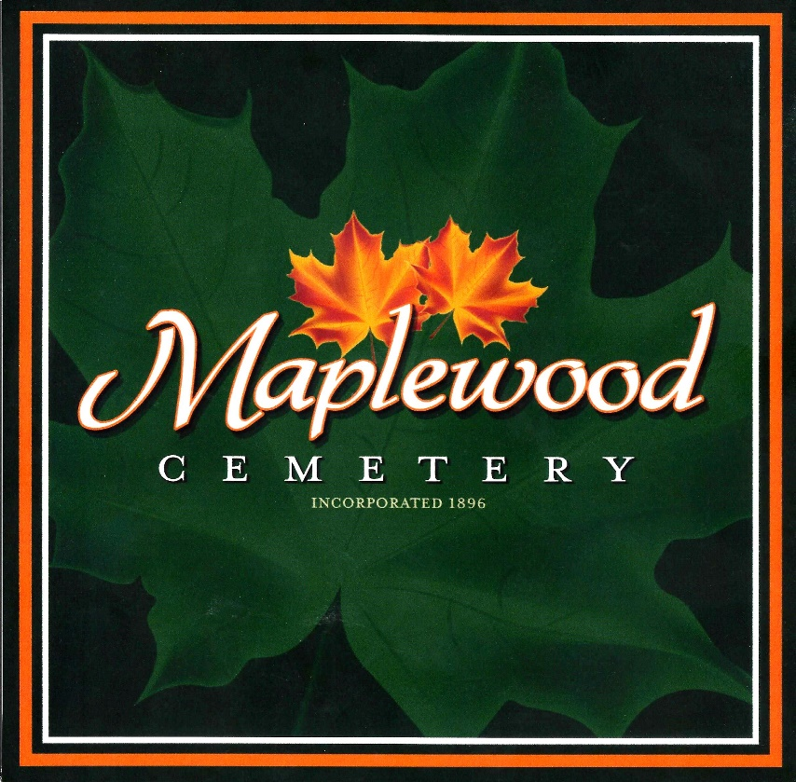
Web Site & Database

Slide 17
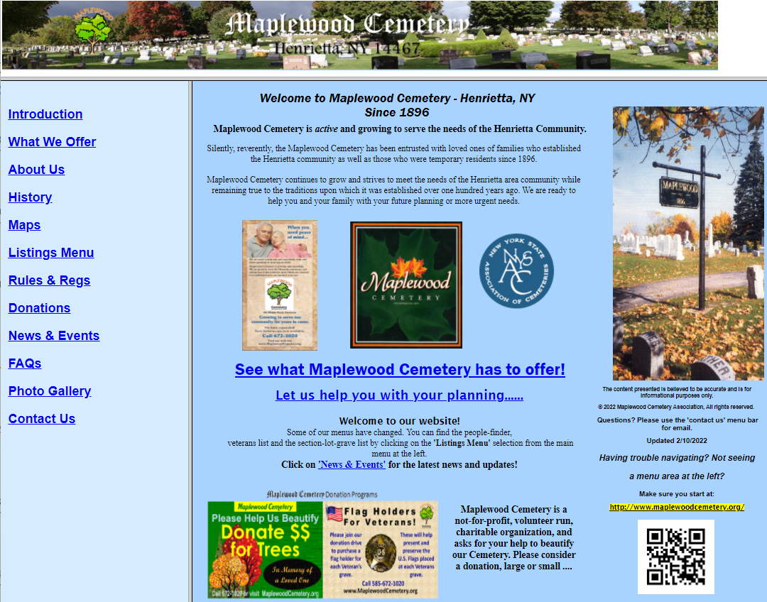
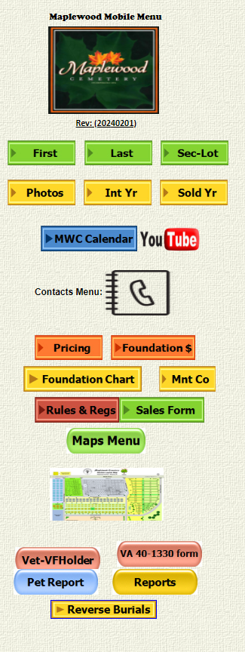
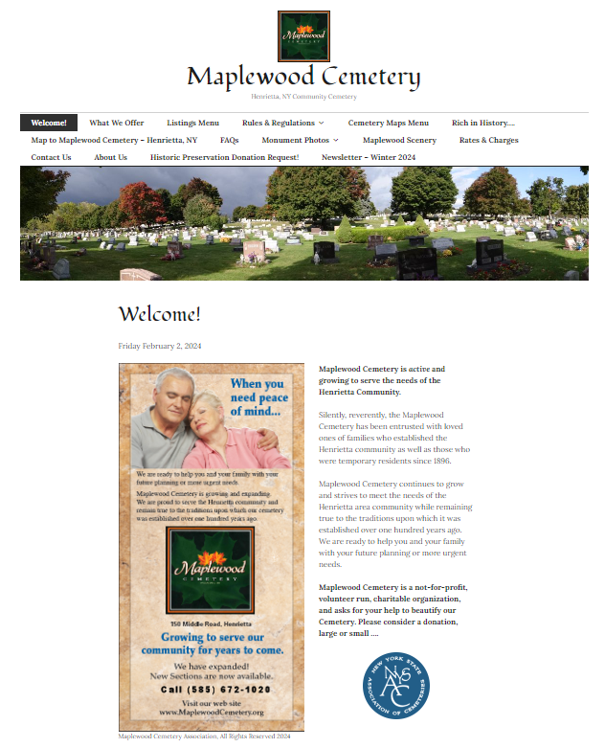
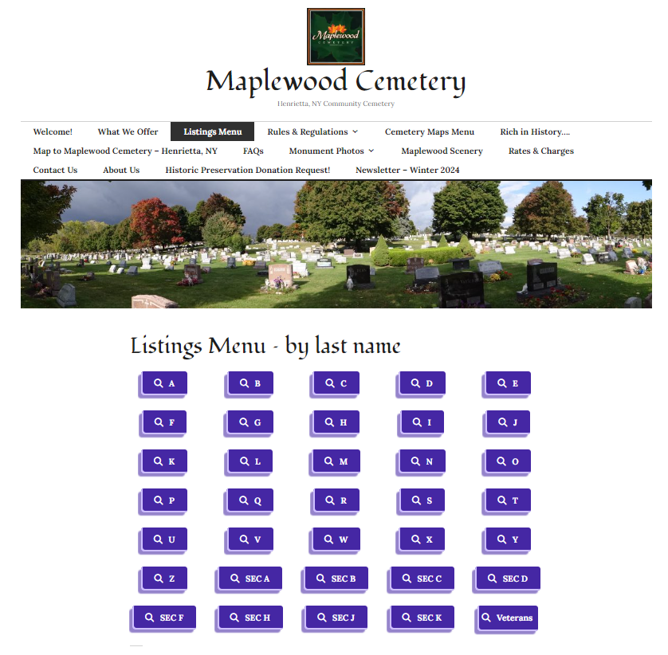
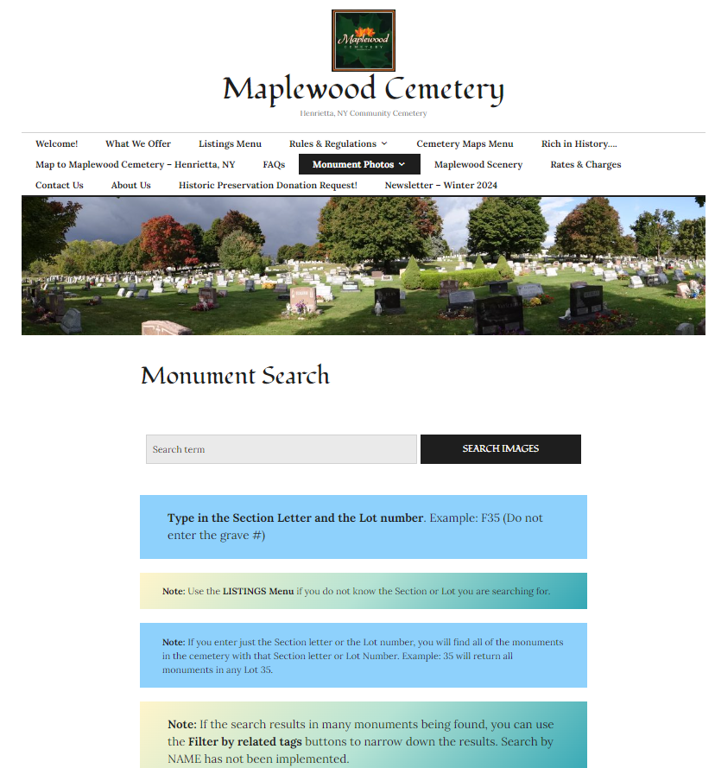
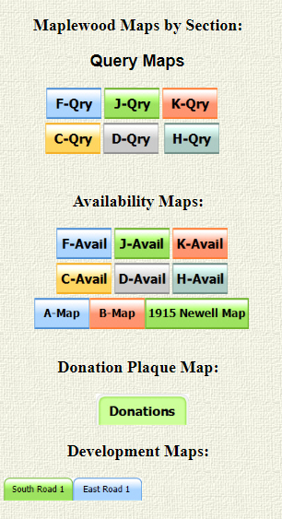

Slide 18
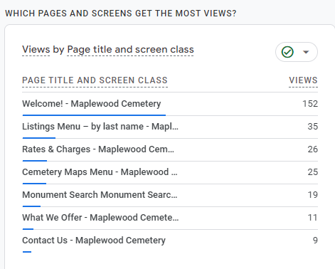
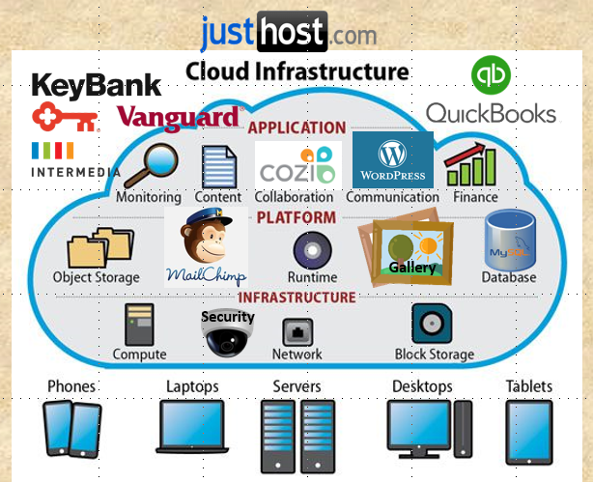

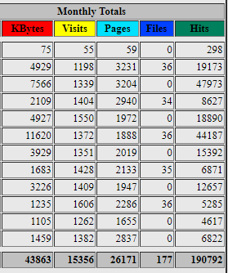
Maplewood Cemetery Association – 2024 Annual Meeting
Infrastructure

Slide 19


Maplewood Cemetery Association – 2024 Annual Meeting
Infrastructure Access
Mobile Banking
Cozi – Event Scheduling
Quick Books Online
Email & Texts
MWC Admin
Lookup names, locations (DB access)
Lookup Maps for locations and Sales
Reports & Training
MaplewoodCemetery.org
Listings, Locations
Monument Photos
Newsletters & More
Reolink Security
Almost everything in our cloud infrastructure is accessible by an app in your cellphone!

Slide 20
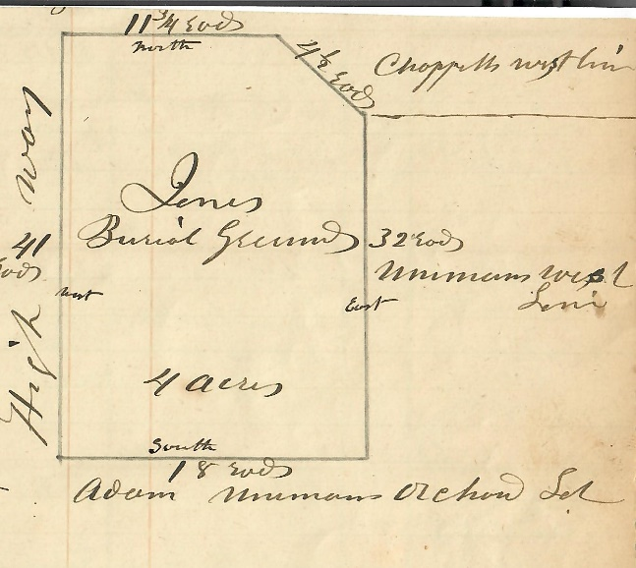
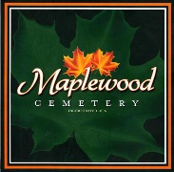
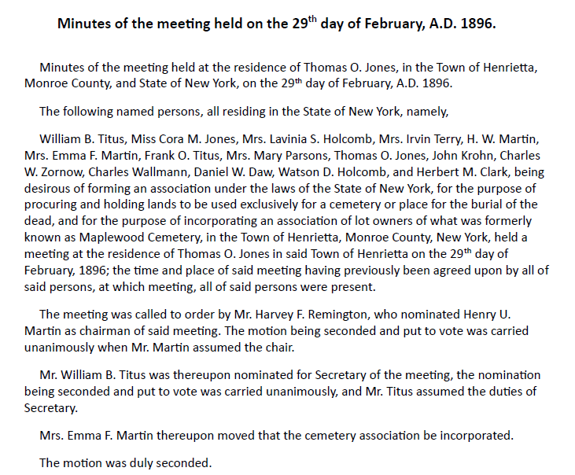
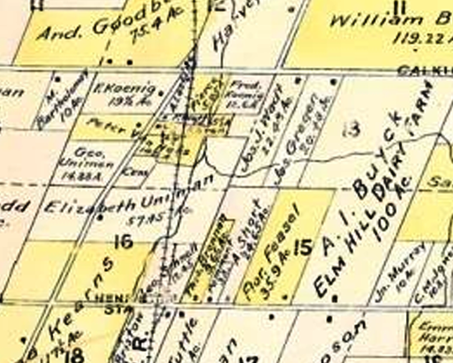
Brief History

Slide 21
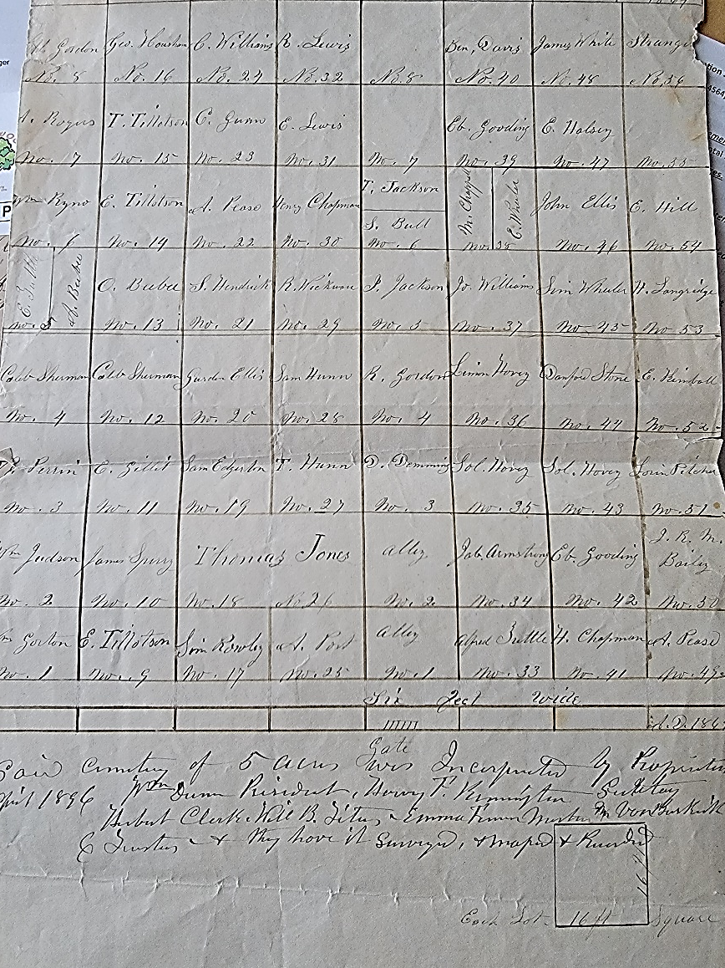
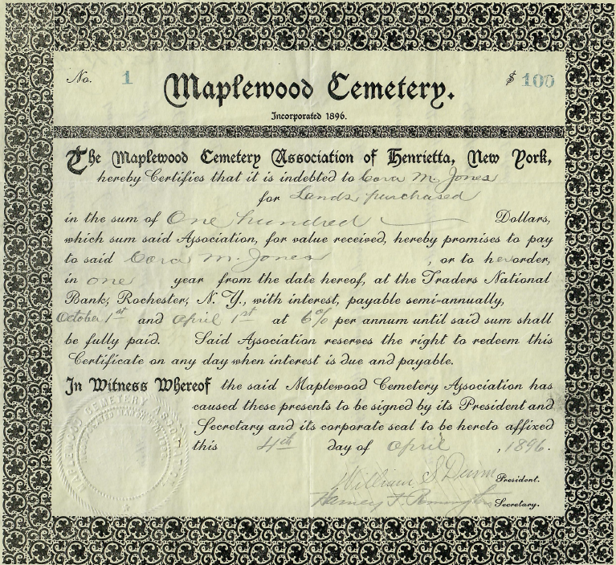
Brief History

Slide 22
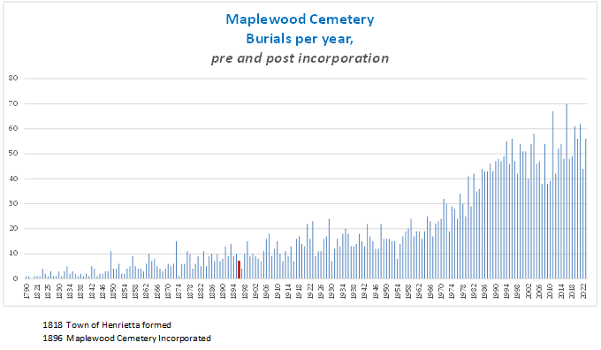
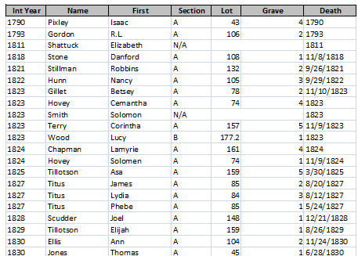
There were 392 ‘known’ burials at Maplewood Cemetery before the 1896 Incorporation….
Brief History
1896
Since 1896 there have been 3567 burials at Maplewood Cemetery.

Slide 23
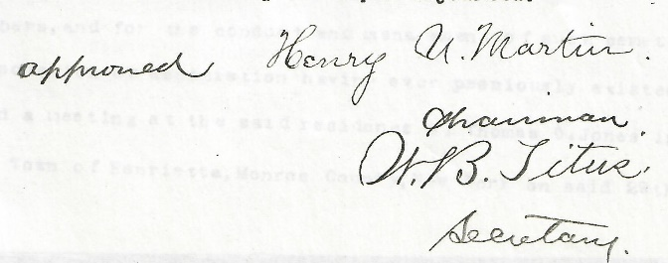
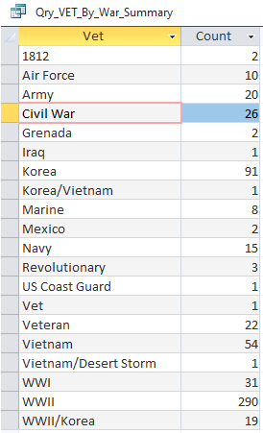
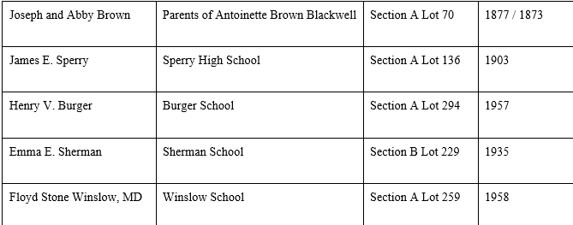
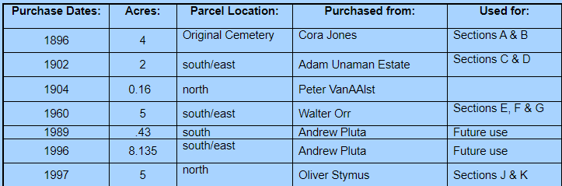
History on Display

Slide 24
New Business &
General Discussion

Slide 25


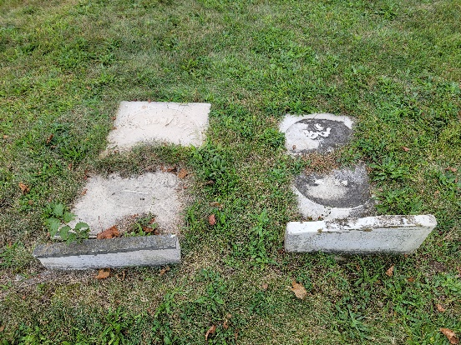
Moving On….
As a Maplewood Cemetery Association member, we need your help!
URGENT: Our board has members that have proudly served our cemetery for years and some will be stepping down soon. The cemetery board meets once a quarter. That’s only 4 times a year. These are informative meetings and decisions are made on how to continue managing the cemetery. You have a vote! Interested in helping? We strongly encourage owner participation.
Association Officers: We hope that you have an interest in being a board member. There are also officer positions that need your help. If you have an interest in helping with our Cemetery Sales, learning how to assist our Treasurer, Secretary or our Webmaster, please volunteer…..
We all know that the cemetery does not run itself.
Preserving History: Many of our monuments are dedicated to our history and are in need of repair and deserve to be preserved. We need help with fundraising and project planning.
How can you help us? Let’s Chat!

Slide 26

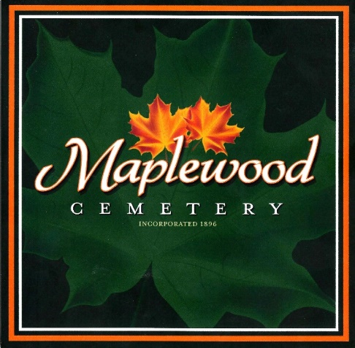
Thank you for attending the
127th Annual Meeting of the
Maplewood Cemetery Association
Hopefully you like what we’ve done with the place!

